Slide 1
CS 3505
Discrete Mathematical Structures
Faria Jameel
faria.jameel@szabist.edu.pk
Consultation hours: 10.00-11.00am Mon-Fri

Slide 2

Conditional Statement
If p then q
p implies q
p is called the hypothesis; q is called the conclusion
The department says:
“If your GPA is 4.0, then you will have full scholarship.”
When is the above sentence false?
It is false when your GPA is 4.0 but you don’t receive full scholarship.
But it is not false if your GPA is below 4.0.
Another example: “If there is typhoon T8 today, then there is no class.”
When is the above sentence false?

Slide 3

Logic Operator
P
Q
P Q
T
T
T
T
F
F
F
T
T
F
F
T
Convention: if we don’t say anything wrong, then it is not false, and thus true.

Slide 4

Logical Equivalence
If you see a question in the above form,
there are usually 3 ways to deal with it.
Truth table
Use logical rules
Intuition

Slide 5
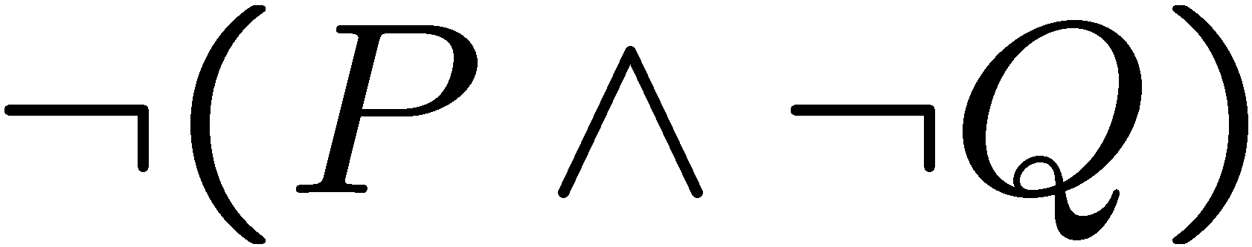

If-Then as Or
P
Q
P Q
Idea 2: Look at the false rows,
negate and take the “and”.
T
T
T
T
F
F
F
T
T
F
F
T
If you don’t give me all your money, then I will kill you.
Either you give me all your money or I will kill you (or both).
If you talk to her, then you can never talk to me.
Either you don’t talk to her or you can never talk to me (or both).

Slide 6
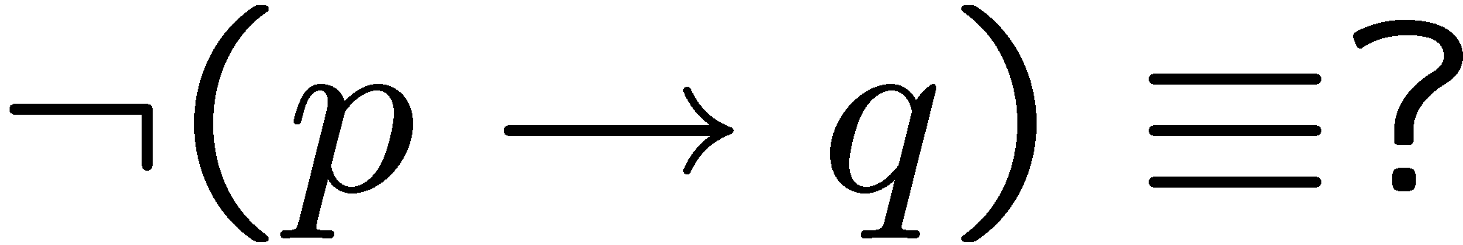
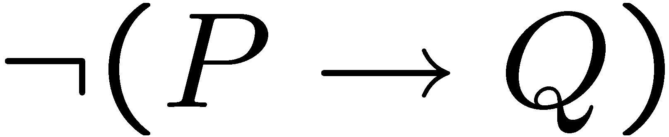



Negation of If-Then
If you eat an apple everyday, then you have no toothache.
You eat an apple everyday but you have toothache.
If my computer is not working, then I cannot finish my homework.
My computer is not working but I can finish my homework.
previous slide
DeMorgan

Slide 7
Contrapositive
The contrapositive of “if p then q” is “if ~q then ~p”.
Statement: If you are a CS year 1 student,
then you are taking CSC 3505.
Contrapositive: If you are not taking CSC 3505,
then you are not a CS year 1 student.
Statement: If x² is an even number,
then x is an even number.
Contrapositive: If x is an odd number,
then x² is an odd number.
Fact: A conditional statement is logically equivalent to its contrapositive.

Slide 8




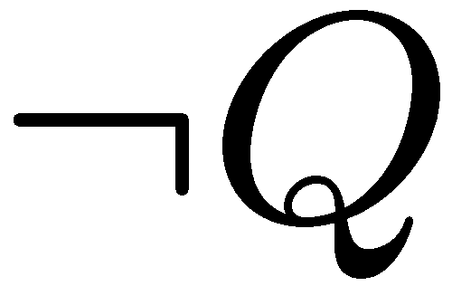

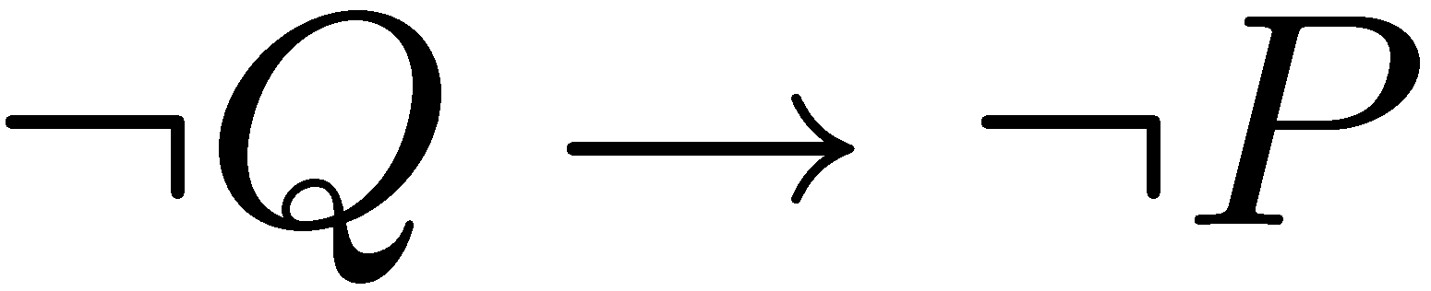


Proofs
Statement: If P, then Q
Contrapositive: If Q, then P.
T | T | T
T | F | F
F | T | T
F | F | T
F | F | T
T | F | F
F | T | T
T | T | T

Slide 9
If, Only-If
You will succeed if you work hand.
You will succeed only if you work hard.
R if S means “if S then R” or equivalently “S implies R”
We also say S is a sufficient condition for R.
R only if S means “if R then S” or equivalently “R implies S”
We also say S is a necessary condition for R.
You will succeed if and only if you work hard.
P if and only if (iff) Q means P and Q are logically equivalent.
That is, P implies Q and Q implies P.

Slide 10





Math vs English
Parent: if you don’t clean your room, then you can’t watch a DVD.
C
D
This sentence says
So
In real life it also means
Mathematician: if a number x greater than 2 is not an odd number,
then x is not a prime number.
This sentence says
But of course it doesn’t mean

Slide 11
Necessary, Sufficient Condition
Mathematician: if a number x greater than 2 is not an odd number,
then x is not a prime number.
This sentence says
But of course it doesn’t mean
Being an odd number > 2 is a necessary condition for this number to be prime.
Being a prime number > 2 is a sufficient condition for this number to be odd.

Slide 12
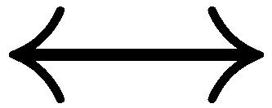

Necessary AND Sufficient Condition
P
Q
P Q
T
T
T
T
F
F
F
T
F
F
F
T
Note: P Q is equivalent to (P Q) (Q P)
Note: P Q is equivalent to (P Q) ( P Q)
Is the statement “x is an even number if and only if x² is an even number” true?

Slide 13
Conditional Statements
If something, then something: p → q, p is called the hypothesis and q is called the conclusion
The only combination of circumstances in which a conditional sentence is false is when the hypothesis is true and the conclusion is false
A conditional statements is called vacuously true or true by default when its hypothesis is false
Among ∧, ∨, ~ and → operations, → has the lowest priority

Slide 14
Conditional Statements
Write truth table for: p ∧ q → ~p
Show that (p ∨ q) → r = (p → r) ∧ (q → r)
Representation of →: p → q = ~p ∨ q
Re-write using if-else: Either you get in class on time, or you risk missing some material
Negation of →: ~(p → q) = p ∧ ~q
Write negation for: If it is raining, then I cannot go to the beach

Slide 15
Conditional Statements
Contrapositive p → q is another conditional statement ~q → ~p
A conditional statement is equivalent to its contrapositive
The converse of p → q is q → p
The inverse of p → q is ~p → ~q
Conditional statement and its converse are not equivalent
Conditional statement and its inverse are not equivalent

Slide 16
Conditional Statements
The converse and the inverse of a conditional statement are equivalent to each other
p only if q means ~q → ~p, or p → q
Biconditional of p and q means “p if and only if q” and is denoted as p ↔ q
r is a sufficient condition for s means “if r then s”
r is a necessary condition for s means “if not r then not s”

Slide 17
Exercises
Write contrapositive, converse and inverse statements for:
  If P is a square, then P is a rectangle
  If today is Thanksgiving, then tomorrow is Friday
  If c is rational, then the decimal expansion of r is repeating
  If n is prime, then n is odd or n is 2
  If x is nonnegative, then x is positive or x is 0
  If Tom is Ann’s father, then Jim is her uncle and Sue is her aunt
  If n is divisible by 6, then n is divisible by 2 and n is divisible by 3

Slide 18
Checkpoint
Conditional Statements
  The meaning of IF and its logical forms
  Contrapositive
  If, only if, if and only if

Slide 19
Propositional Logic - special definitions
One of these things is not like the others.
Contrapositives: p → q and ¬q → ¬p
  Ex. “If it is noon, then I am hungry.”
  “If I am not hungry, then it is not noon.”
Converses: p → q and q → p
  Ex. “If it is noon, then I am hungry.”
  “If I am hungry, then it is noon.”
Inverses: p → q and ¬p → ¬q
  Ex. “If it is noon, then I am hungry.”
  “If it is not noon, then I am not hungry.”
Hint: In one instance, the pair of propositions is equivalent.
p → q ≡ ¬q → ¬p

Slide 20
Propositional Logic - logical equivalence
How many different logical connectives could we define?
16
How many different logical connectives do we need?
??
To answer, we need the notion of
“logical equivalence.”
p is logically equivalent to q if their truth tables are the same. We write p ≡ q.

Slide 21
Propositional Logic - logical equivalence
Challenge: Try to find a proposition that is equivalent to p → q, but that uses only the connectives ¬, ∧, and ∨.
p | q | p → q
T T F F | T F T F | T F T T
p | q | ¬ p | q ∨ ¬p
T T F F | T F T F | F F T T | T F T T

Slide 22
Propositional Logic -
I could say “prove a law of distributivity.”
Distributivity: p ∨ (q ∧ r) ≡ (p ∨ q) ∧ (p ∨ r)
p | q | r | q ∧ r | p ∨ (q ∧ r) | p ∨ q | p ∨ r | (p ∨ q) ∧ (p ∨ r)
T | T | T | T | T | T | T | T
T | T | F | F | T | T | T | T
T | F | T | F | T | T | T | T
T | F | F | F | T | T | T | T
F | T | T | T | T | T | T | T
F | T | F | F | F | T | F | F
F | F | T | F | F | F | T | F
F | F | F | F | F | F | F | F
All truth assignments for p, q, and r.

Slide 23
Logical Equivalences
DEF: Two compound propositions p, q are logically equivalent if their biconditional joining p ↔ q is a tautology. Logical equivalence is denoted by p ⇔ q.
EG: The contrapositive of a logical implication is the reversal of the implication, while negating both components. I.e. the contrapositive of p →q is ¬q →¬p . As we’ll see next: p →q ⇔ ¬q →¬p

Slide 24
Logical Equivalence of Conditional and Contrapositive
The easiest way to check for logical equivalence is to see if the truth tables of both variants have identical last columns:
p
q
p →q
p
q
¬q
¬p
¬q→¬p
Q: why does this work given definition of ⇔ ?

Slide 25
Logical Equivalence of Conditional and Contrapositive
The easiest way to check for logical equivalence is to see if the truth tables of both variants have identical last columns:
p
q
p →q
p
q
¬q
¬p
¬q→¬p
T
T
F
F
T
F
T
F
T
F
T
T
Q: why does this work given definition of ⇔ ?

Slide 26
Logical Equivalence of Conditional and Contrapositive
The easiest way to check for logical equivalence is to see if the truth tables of both variants have identical last columns:
p
q
p →q
p
q
¬q
¬p
¬q→¬p
T
T
F
F
T
F
T
F
T
F
T
T
T
T
F
F
T
F
T
F
Q: why does this work given definition of ⇔ ?

Slide 27
Logical Equivalence of Conditional and Contrapositive
The easiest way to check for logical equivalence is to see if the truth tables of both variants have identical last columns:
p
q
p →q
p
q
¬q
¬p
¬q→¬p
T
T
F
F
T
F
T
F
T
F
T
T
T
T
F
F
T
F
T
F
F
T
F
T
Q: why does this work given definition of ⇔ ?

Slide 28
Logical Equivalence of Conditional and Contrapositive
The easiest way to check for logical equivalence is to see if the truth tables of both variants have identical last columns:
p
q
p →q
p
q
¬q
¬p
¬q→¬p
T
T
F
F
T
F
T
F
T
F
T
T
T
T
F
F
T
F
T
F
F
T
F
T
F
F
T
T
Q: why does this work given definition of ⇔ ?

Slide 29
Logical Equivalence of Conditional and Contrapositive
The easiest way to check for logical equivalence is to see if the truth tables of both variants have identical last columns:
p
q
p →q
p
q
¬q
¬p
¬q→¬p
T
T
F
F
T
F
T
F
T
F
T
T
T
T
F
F
T
F
T
F
F
T
F
T
F
F
T
T
T
F
T
T
Q: why does this work given definition of ⇔ ?

Slide 30
Logical Equivalences
A: p ⇔q by definition means that p ↔ q is a tautology. Furthermore, the biconditional is true exactly when the truth values of p and of q are identical. So if the last column of truth tables of p and of q is identical, the biconditional join of both is a tautology.

Slide 31
Logical Non-Equivalence of Conditional and Converse
The converse of a logical implication is the reversal of the implication. I.e. the converse of p →q is q →p.
EG: The converse of “If Donald is a duck then Donald is a bird.” is “If Donald is a bird then Donald is a duck.”
As we’ll see next: p →q and q →p are not logically equivalent.

Slide 32
Logical Non-Equivalence of Conditional and Converse
p | q | p →q | q →p | (p →q) ↔ (q →p)

Slide 33
Logical Non-Equivalence of Conditional and Converse
p | q | p →q | q →p | (p →q) ↔ (q →p)
T T F F | T F T F

Slide 34
Logical Non-Equivalence of Conditional and Converse
p | q | p →q | q →p | (p →q) ↔ (q →p)
T T F F | T F T F | T F T T

Slide 35
Logical Non-Equivalence of Conditional and Converse
p | q | p →q | q →p | (p →q) ↔ (q →p)
T T F F | T F T F | T F T T | T T F T

Slide 36
Logical Non-Equivalence of Conditional and Converse
p | q | p →q | q →p | (p →q) ↔ (q →p)
T T F F | T F T F | T F T T | T T F T | T F F T

Slide 37
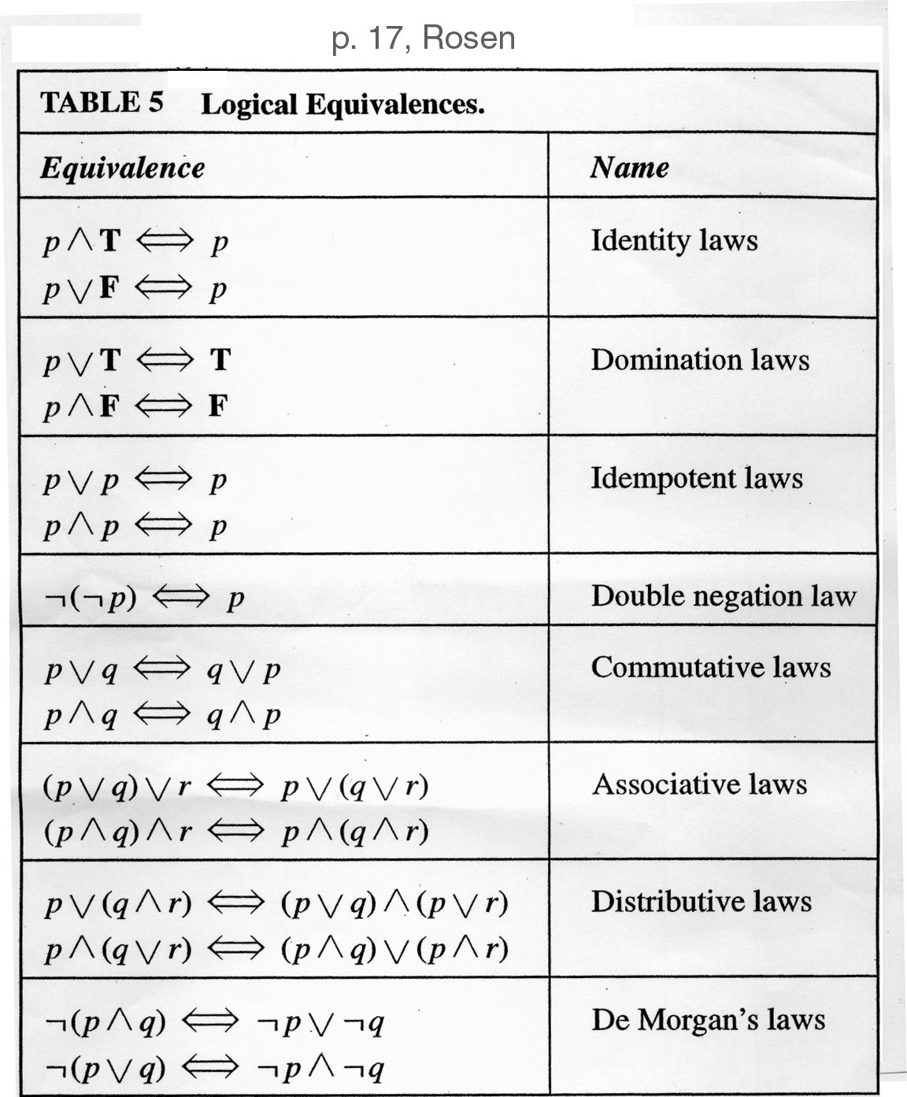
Tables of Logical Equivalences
    Identity laws
      Like adding 0
    Domination laws
      Like multiplying by 0
    Idempotent laws
      Delete redundancies
    Double negation
      “I don’t like you, not”
    Commutativity
      Like “x+y = y+x”
    Associativity
      Like “(x+y)+z = y+(x+z)”
    Distributivity
      Like “(x+y)z = xz+yz”
    De Morgan

Slide 38
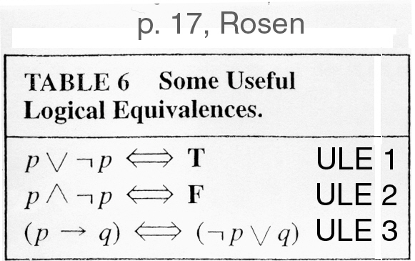
Tables of Logical Equivalences
    Excluded middle
    Negating creates opposite
    Definition of implication in terms of Not and Or

Slide 39
DeMorgan Identities
DeMorgan’s identities allow for simplification of negations of complex expressions
Conjunctional negation:
  ¬(p₁∧p₂∧…∧p_{n}) ⇔ (¬p₁∨¬p₂∨…∨¬p_{n})
  “It’s not the case that all are true iff one is false.”
Disjunctional negation:
  ¬(p₁∨p₂∨…∨p_{n}) ⇔ (¬p₁∧¬p₂∧…∧¬p_{n})
  “It’s not the case that one is true iff all are false.”

Slide 40
Examples for section 1.2
Worked out on the black-board.
“I don’t drink and drive” is logically equivalent to “If I drink, then I don’t drive”
Write a Java method that represents the compound proposition (p→q)←→r

